Slide 1




Antiretroviral therapy in elderly individuals living with HIV
Catia Marzolini
University Hospital & University of Basel
University of Liverpool

Slide 2
Disclosures
Research Grant: Gilead
Speaker: MSD, Gilead

Slide 3
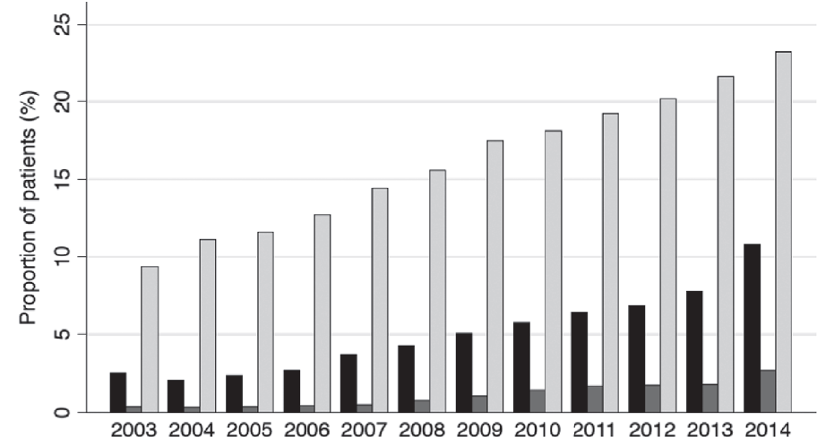

Aging of HIV population
Age distribution of PLWH in the SHCS
Proportion of > 50 years old PLWH
in a multi-site cohort in Brazil
100%
80%
60%
>70
61-70
% patients
51-60
40%
41-50
31-40
20%
21-30
18-20
0%
88 90 92 94 96 98 00 02 04 06 08 10 12 14 16
year
PLWH > 50 years old
prevalence of > 2 comorbidities
Mathematical models using data from US, Italian and Dutch
HIV Cohort project that 30-40% of PLWH will be > 60-65 years
with > 3 comorbidities by 2030-2035.
prevalence of > 3 comorbidities
Most common comorbidities: hyperlipidemia
and diabetes
Smit M et al. Lancet Infect Dis 2015; Smit M et al. PLoS One 2017
Castilho JL et al. J Int AIDS Soc 2019

Slide 4
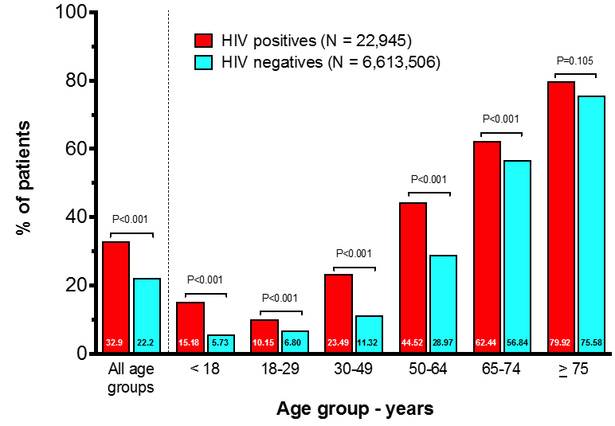
Polypharmacy in PLWH and uninfected individuals
Prevalence of polypharmacy (> 5 non-HIV drugs) in PLWH and uninfected individuals who picked up prescription drugs in hospital and community pharmacies in the region of Madrid
P values refer to comparisons of proportions of patients with polypharmacy (≥ 5 Co-meds) between groups
Lopez-Centeno B et al. Glasgow HIV Conference 2018

Slide 5
Prevalence of polypharmacy in PLWH
Reference | Country | N | Age | Polypharmacy
Livio F et al. Int Work Clin Pharm HIV 2018 | Switzerland | 111 | > 75 | 60 %
Courlet P et al. CROI 2019 | Switzerland | 131 | > 65 | 46 %
Guaraldi G et al. BMC Geriatr 2018 | Italy | 1258 | > 65 | 37 %
Justice A et al. AIDS 2018 | USA | 1311 | > 65 | 43 %
Halloran MO et al. Antivir Ther 2019 | UK/Ireland | 698 | > 50 | 30 %
Lopez-Centeno B et al. HIV Drug Ther, Glasgow 2018 | Spain | 10073 | > 50 | 47 %
Nunez-Nunez M et al. Farm Hosp 2018 | Spain | 242 | > 50 | 48 %
Ruzicka DJ et al. BMJ Open 2018 | Japan | 526 | > 50 | 35%
Ssonko M et al. BMC Geriatr 2018 | Uganda | 411 | > 50 | 15 %
Krentz H et al. AIDS Pat Care STDS 2016 | Canada | 386 | > 50 | 43 %
Holtzman C et al. J Gen Intern Med 2013 | USA | 1312 | > 50 | 54 %

Slide 6
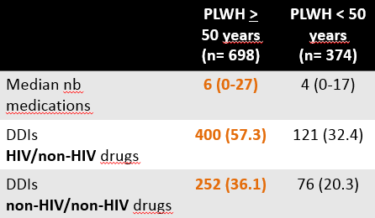
Consequences of polypharmacy
Polypharmacy
> 5 medications
Nonadherence
Drug-drug interactions
Possible causes:
Side effets
High pill burden
Complex dosing regimens
Depression
Neurocognitive impairment
Size of tablets
Limited health literacy
(misunderstanding of
instructions)
Health beliefs
(being unconvinced about
necessity of medication)
Adverse drug reactions
Most common drug classes associated with ADR in elderly:
Cardiovascular drugs
Diuretics
Anticoagulants
NSAIDs
Antidiabetics
Older PLWH receive more medications and therefore are at > risk for DDIs between HIV/non-HIV drugs and
between non-HIV/non-HIV drugs
Geriatric syndromes
Falls
Cognitive decline
Orthostatic hypotension
Shah B et al. Clin Geriatr Med 2012, Gellad WF et al. Am J Geriatr Pharmacother 2011, Halloran MO et al. Antivir Ther 2019

Slide 7
Aging & comorbidities pose additional therapeutic challenges
Drug-disease interactions
Examples
Disease | Drug | Potential adverse reaction
Diabetes | corticosteroids | increase in blood glucose level
Parkinson | antipsychotics | aggravation of movement disorder
Renal failure | NSAIDs | decrease of glomerular filtration rate
Age associated changes in pharmacokinetics
PK parameter | Altered physiology with aging | Comments
Absorption | ↑ gastric pH | modification of drug absorption
Distribution | ↓ albumin ↑ body fat ↓ lean muscle and total body water | ↑ free fraction of drugs ↑ Vd of lipophilic drugs ↑ plasma concentration of hydrophilic drugs
Metabolism | ↓ hepatic mass ↓ hepatic blood flow | ↓ reduced hepatic clearance
Elimination | ↓ kidney mass ↓ glomerular filtration rate ↓ renal blood flow | ↓ reduced renal clearance
Wooten JM. South Med J 2012, Marzolini C et al. Expert Rev Clin Pharmacol 2019

Slide 8
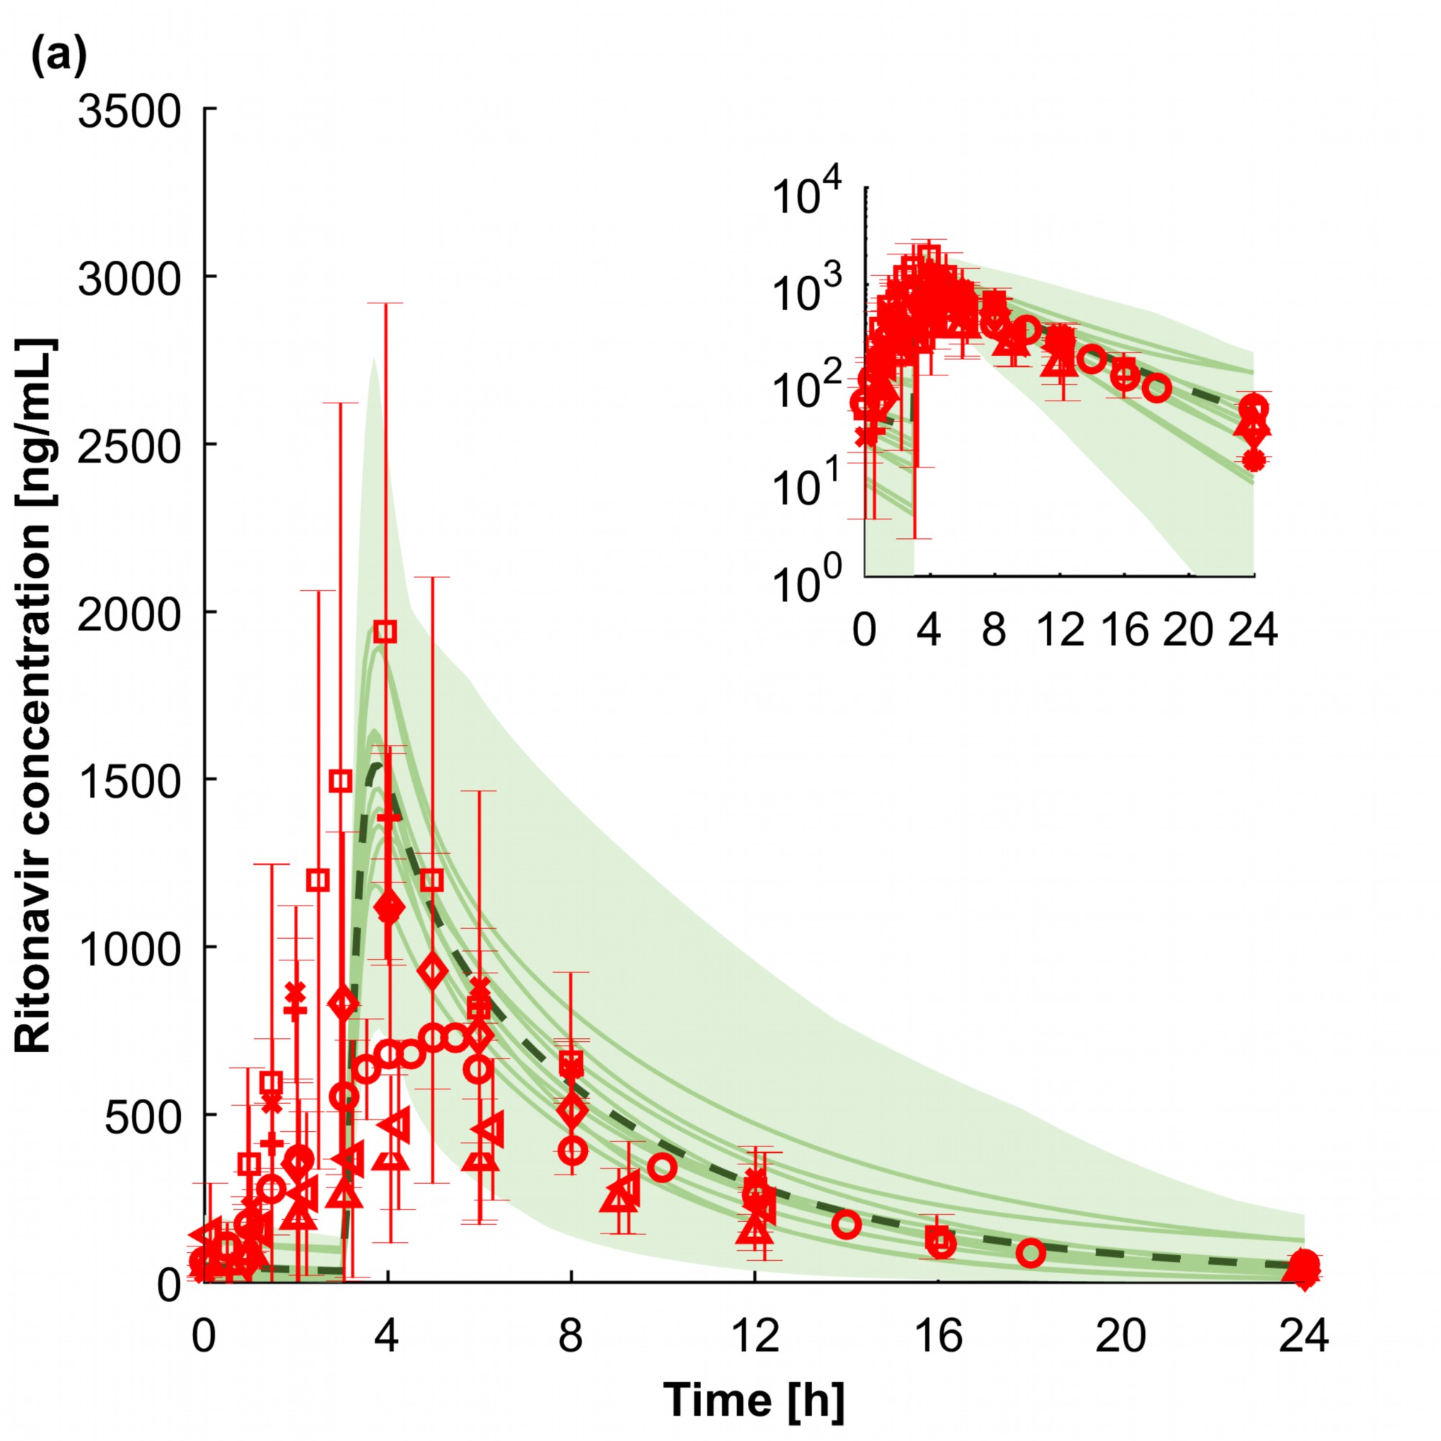
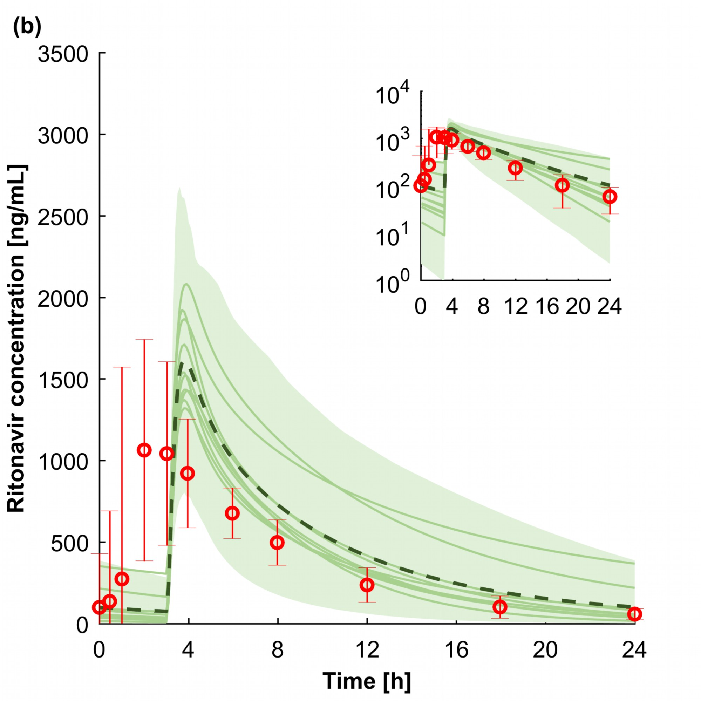
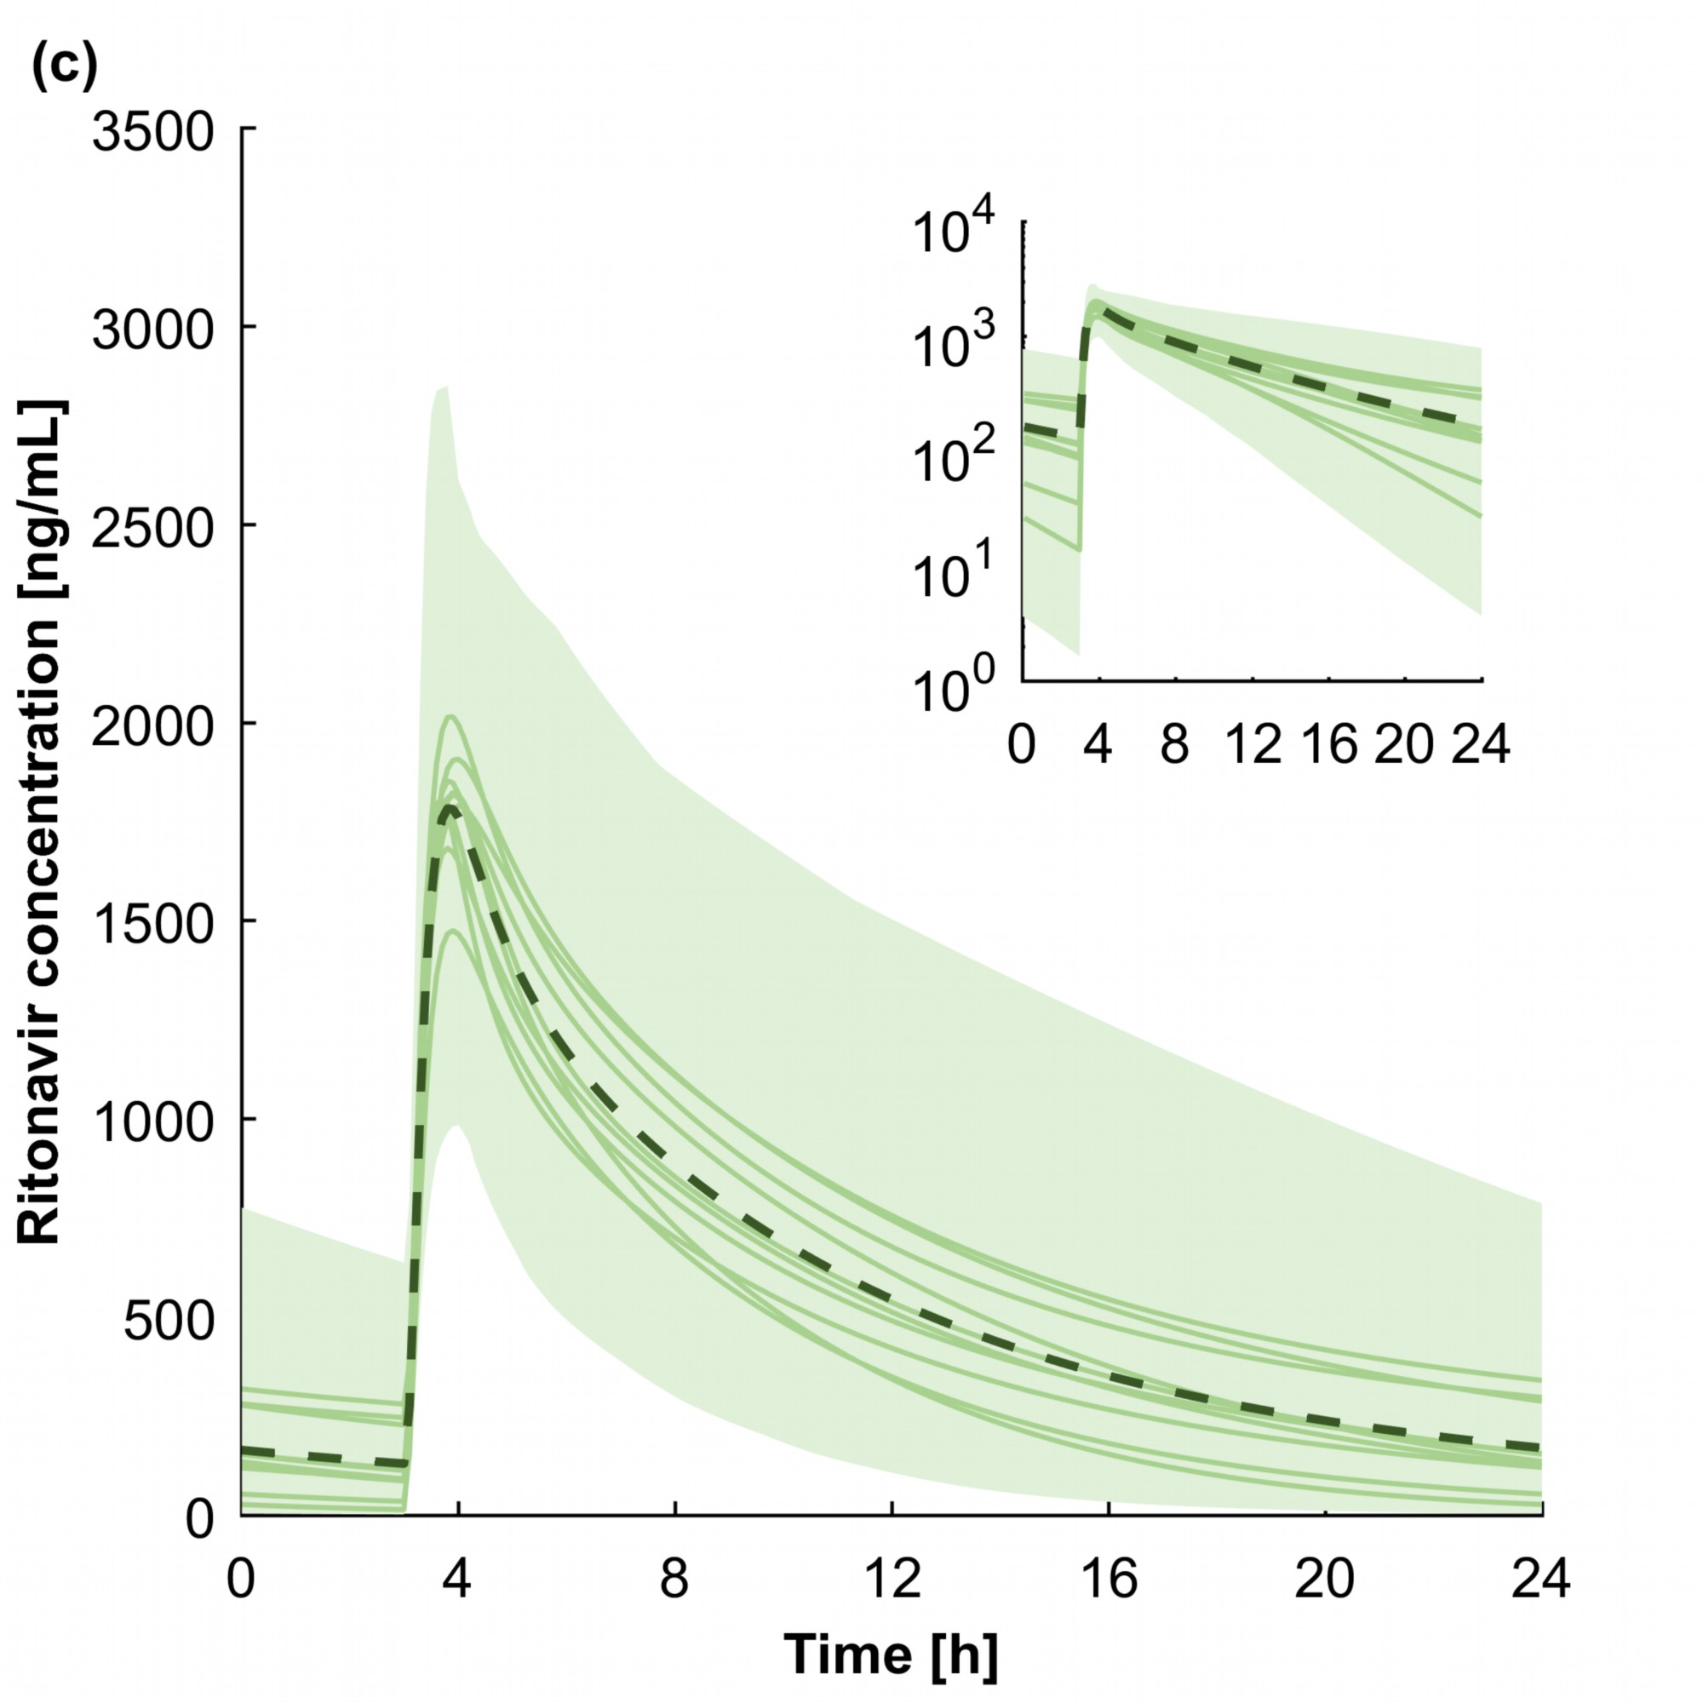
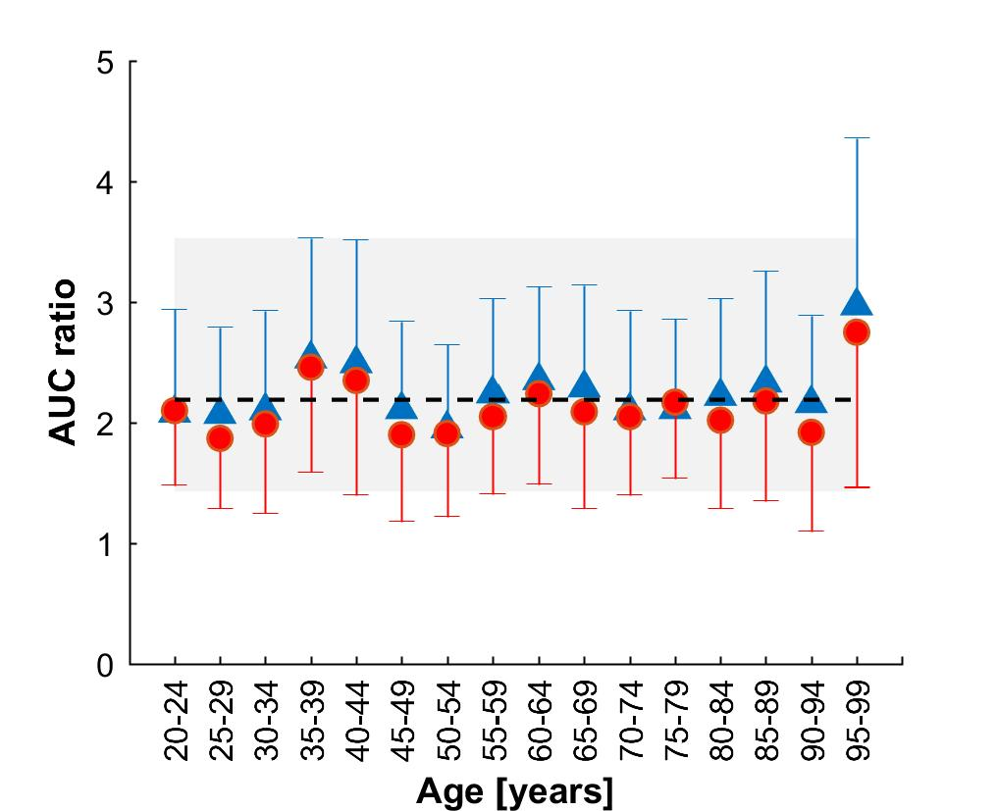
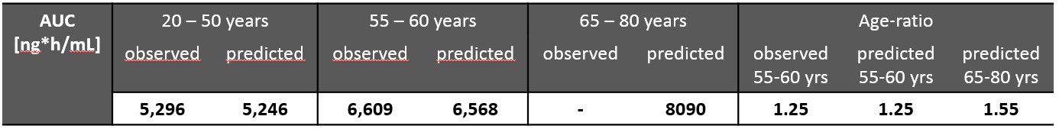
PK of ritonavir (100 mg QD) in elderly & magnitude of DDIs in elderly
Adults aged 20-50 years
Adults aged 55-60 years
Adults aged 65-80 years
Impact of age on DDI magnitude
DRV/r +/- rivaroxaban
men
women
AUC Rivaroxaban + DRV/r
AUC Rivaroxaban alone
Observed clinical data
Mean of all predictions
Mean of each virtual trial
95% CI of predictions
DDIs have a similar magnitude in elderly compared to young adults
Advanced age does not impact ritonavir exposure to a clinically significant extent
Dumond J et al. HIV Medicine 2013; Stader F et al. International Workshop Clin Pharmacol Antivir Ther 2019; Stader F et al. CROI 2019

Slide 9
Aging & comorbidities pose additional therapeutic challenges
Age associated changes in pharmacodynamics:
- changes in affinity of some medications to receptor sites or in number of receptors
➔ affect efficacy or increase sensitivity to certain drugs
- regulation of some physiologic processes (i.e renal hemodynamics) altered with aging
Examples
Drug class | Potential PD issues | Comments
Antihypertensives | orthostatic hypotension | start with lower dose
Benzodiazepines | ↑ sensitivity (sedation, confusion…) | use with caution and for short period of time, use lowest dose
Opioids | ↑ sensitivity | use with caution, use lowest dose
β-blockers | ↓ β-receptors function | may require ↑ β-blocker dose
Diuretics | ↑ sensitivity drug effect | monitor blood pressure and electrolytes
Vitamin K antagonists | ↑ sensitivity (inhibition synthesis of vitamin K dependent clotting factors) | start with lower dose and adjust based on INR
Anticholinergic agents | ↑ sensitivity (delirium, dry mouth, constipation, urinary retention, cognitive impairment, falls…) | avoid
Wooten JM. South Med J 2012, Marzolini C et al. Expert Rev Clin Pharmacol 2019

Slide 10
Drugs with anticholinergic effects and cognitive performance
Cognitive performance
worse cognitive
performance
Total number of anti-cholinergic drugs
Rubin L et al. JAIDS 2018
Selected anticholinergic drugs
amitriptyline | clozapine | imipramine | promethazine
atropine | darifenacin | nortriptyline | scopolamine
chlorpheniramine | desipramine | olanzapine | thioridazine
chlorpromazine | diphenhydramine | oxybutynin | tolterodine
clomipramine | doxepin | paroxetine | trimipramine
Boustani M et al. Aging Health 2008

Slide 11
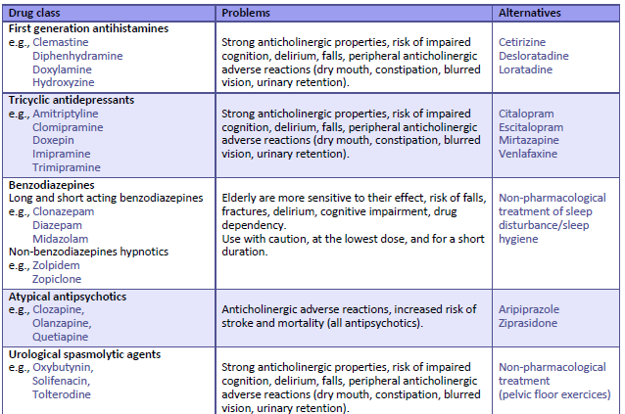
www.hiv-druginteractions.org

Slide 12
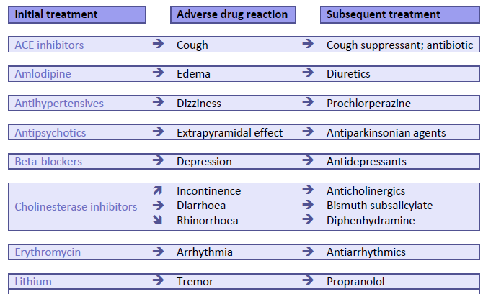
www.hiv-druginteractions.org

Slide 13
Prevalence of prescribing issues in SHCS patients > 75 years
Overall prescribing issues : 69% participants
www.hiv-druginteractions.org
Incorrect drug dosage: 25%
No indication: 21%
Prescription omission: 19%
Inappropriate drug: 19%
Deleterious DDIs: 14%
Treatment duration exceeding 2%
recommendations:
40% of the prescribing issues could possibly lead to deleterious clinical consequences
Prescribing issues more frequent with non-HIV comeds
Education on geriatric medicine principles and periodic review of prescriptions could reduce polypharmacy and prescribing errors
WEPEB314 Cabanilla G et al. Risk of polypharmacy and inappropriate prescribing in persons living with HIV > 65 years of age
Livio F. International Workshop Clin Pharmacol Antivir Ther 2018

Slide 14
Interventions to limit/manage polypharmacy
Medication reconciliation
  Establish list of current prescription & over-the-counter drugs to be updated at each medical visit
2) Periodic medication review
  Check indication ➔ discontinuation of unecessary drugs
  Identify medications treating adverse effects of other medications
  ➔ discontinue drug that is causing side effect if possible
  Check dosing of medications ➔ simplification of dosing regimen when possible
  Check for drug-drug interactions ➔ ARV with low DDI potential when possible
  Check for inappropriate drugs in elderly
  Check for any missing medicine
Beers and STOPP/START criteria
Medication prioritization
  Consider risk/benefit of each medication within the context of a given patient’s care goals, current level of functioning, life expectancy and preference
Shah B et al. Clin Geriatr Med 2012, Edelman E et al. Drugs Aging 2013, O’Mahony D et al. Age and Ageing 2015, American Geriatrics Society. J Am Geriatr Soc 2015

Slide 15
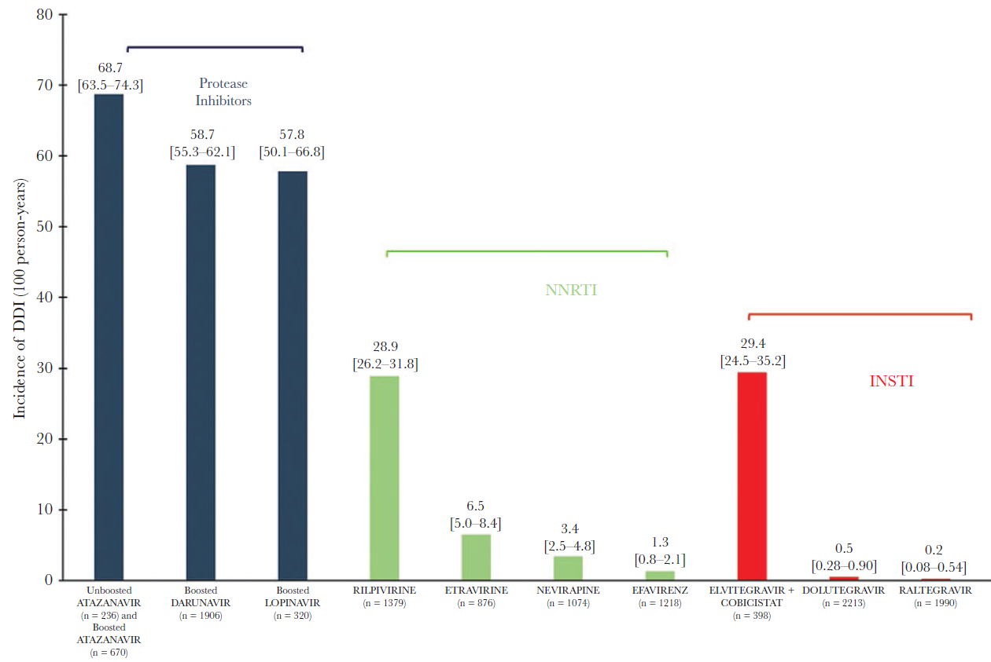
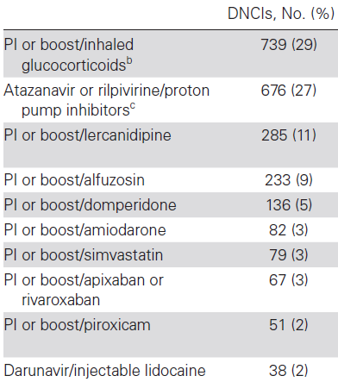
Risk and cost associated with DDIs in elderly PLWH
Frequency, risks and costs attributable to «red flag DDIs» (Liverpool database) using French nationwide health e-records for 2016:
9076 PLWH, mean age: 71 + 5 years, median non-HIV comeds (IQR): 14 (9-21)
16.8% > 1 DDI, unboosted INI associated with lower risk for DDI (OR: 0.02), boosted PIs increased risk for DDI (OR: 4.12)
Presence of DDIs associated with additional 2693 USD/year
Incidence of DDI per 100 person-years
10 most frequent encountered DDIs
PI
Risk
Cushing syndrome
↓ ARV efficacy
hypotension &
cardiac disorders
severe hypotension
68.7
58.7
57.8
NNRTI
INSTI
Incidence DDI (100 person-years)
28.9
29.4
QT prolongation
QT prolongation
rhabdomyolysis
bleeding
6.5
3.4
1.3
0.5
0.2
respiratory depression
& hematologic abnorm.
EFV
DTG
RAL
ATV
ATV/r
DRV/r
LPV/r
RPV
ETV
NVP
EFV
EVG/c
QT prolongation
Desmessine L et al. Open Forum Infect Dis 2019

Slide 16
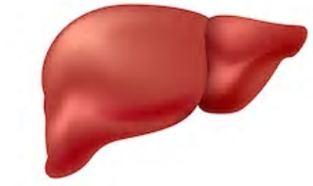
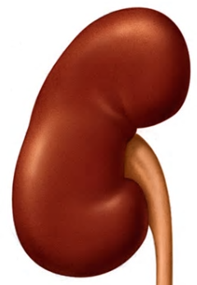
Mechanisms of drug-drug interactions with antiretroviral agents
Inhibition/induction of hepatic cytochromes,
glucuronidation, or drug transporters
Inhibition/induction intestinal cytochromes or drug transporters
victim
perpetrator
victim
perpetrator
Metabolism
doravirine
rilpivirine
bictegravir
Tenofovir
(TDF, TAF)
maraviroc
PI/r
PI/c
elvitegravir/c
doravirine
rilpivirine
bictegravir
dolutegravir
raltegravir
maraviroc
PI/r
PI/c
elvitegravir/c
efavirenz
etravirine
nevirapine
Change gastric pH
liver
Absorption
victim
atazanavir
rilpivirine
Inhibition of renal drug
transporters
Excretion
Chelation with mineral supplements
victim
perpetrator
victim
tenofovir
bictegravir
dolutegravir
cobicistat
ritonavir
bictegravir
dolutegravir
elvitegravir/c
raltegravir
kidney
small
intestine
Marzolini C et al. Expert Rev Clin Pharmacol 2019

Slide 17
Drug-drug interactions profiles of antiretroviral drugs
n ≈ 700 comedications
boosted ARV
Raltegravir
Dolutegravir
Bictegravir
Efavirenz
Etravirine
Rilpivirine
Doravirine
no interaction
Interaction of weak clinical relevance
www.hiv-druginteractions.org
interaction of clinical relevance
deleterious interaction

Slide 18
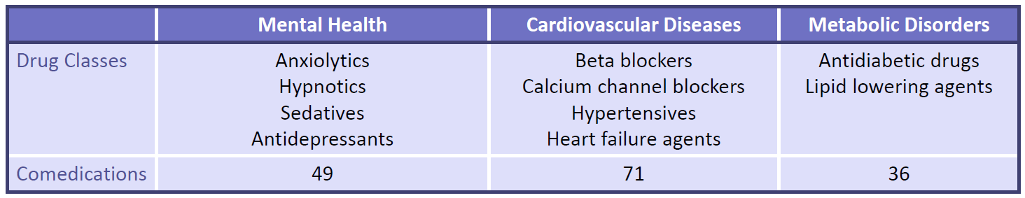
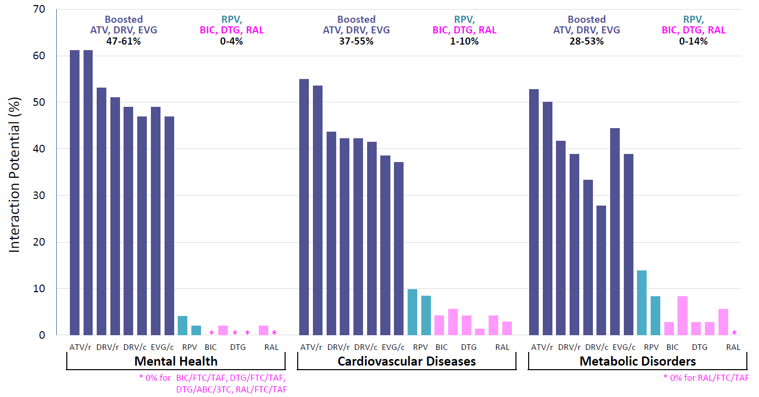
Amber/red DDIs of ARV regimens with treatments of common comorbidities
Gibbons S et al. 20th Workshop on Clin Pharmacol of HIV 2019, www.hiv-druginteractions.org

Slide 19
Selected drug-drug interactions of interest in elderly PLWH
Drug class | ARV | comment
PPIs, antacids, H2 inhibitors | ATV RPV | Decreased solubility of ATV, RPV. Contraindicated with PPIs; antacids, H2 inhibitors: separate drug intake.
Calcium, mineral supplements, antacids | INSTIs | Chelation with divalent cations causing reduced absorption of INSTIs. Separate drug intake.
Corticosteroids | PI/r PI/c EVG/c | Risk of Cushing syndrome (cave: eye drops, local injection, topical administration…). Triamcinolone, budesonide, fluticasone, mometasone are contraindicated.
Antidepressants | PI/r PI/c EVG/c | Avoid tricyclic antidepressants due to anticholinergic effects. Caution: escitalopram/citalopram + ATV, LPV or SQV (risk QT interval prolongation).
Benzodiazepines | PI/r PI/c EVG/c | Avoid in elderly due to risk of cognitive impairment, falls and fractures. Midazolam, triazolam are contraindicated.
Chemotherapy drugs | PI/r PI/c EVG/c | Risk of chemotherapy related toxicities. Limited data to guide DDIs management. Favour ARVs with a low potential for metabolic DDIs when possible.
Marzolini C et al. Expert Rev Clin Pharmacol 2019, www.hiv-druginteractions.org

Slide 20
Selected drug-drug interactions of interest in elderly PLWH
Drug class | ARV | comment
NSAIDs | TDF | Avoid long term use and closely monitor renal function.
Calcium channel blockers | PI/r PI/c EVG/c | Increased exposure. Start at lower dose and titrate based on response to therapy. Lecarnidipine is contraindicated.
Statins | PI/r PI/c EVG/c | Increased exposure of some statins, risk of rhabdomylosis. Simvastatin, lovastatin are contraindicated.
Antidiabetics | PI/r PI/c EVG/c DTG, BIC | DTG increases metformin exposure. Avoid high dose metformin. BIC: consider dose adjustment in patients with moderate renal impairment. Saxagliptin: limit to 2.5 mg daily with boosted ARVs.
Anticoagulants vitamin K antagonists | PI/r PI/c EVG/c | Adjust dosage by closely monitoring INR. Dosage adjustement might be needed when switching booster.
Direct acting anticoagulants | PI/r PI/c EVG/c | Apixaban, rivaroxaban: avoid. Dabigatran: possible with PI/r but not recommended with PI/c. Edoxaban: consider a dose reduction from 60 to 30 mg.
Marzolini C et al. Expert Rev Clin Pharmacol 2019, www.hiv-druginteractions.org

Slide 21
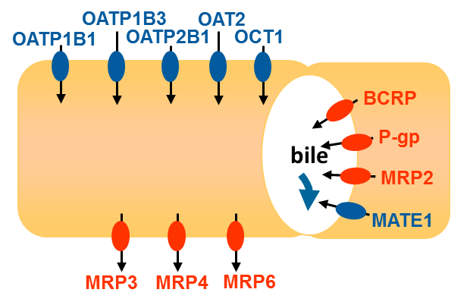
Drug-drug interactions between boosted ARV and statins
Differences in magnitude of drug-drug interactions with statins explained by different metabolic pathways and affinities to drug transporters.
ATV/c
↑822%
ATV/r | DRV/c | DRV/r | LPV/r | EVG/c
↑ | ↑290% | ↑ | ↑490% | ↑
↑213% | ↑93% | ↑48% | ↑107% | ↑38%
Atorvastatin + DRV/r
Atorvastatin +
(CYP3A4 + transporters)
Liver
Rosuvastatin +
(transporters)
↑242%
CYP3A4
OATP1B1 inhibition: ATV > LPV > DRV > RTV, Cobi
Recommendations
 | ATV/c | DRV/c
Atorvastatin | NR/lowest dose Max: 10 mg/d | lowest dose Max: 40 mg/d (US label: 20 mg/d)
Rosuvastatin | lowest dose Max: 10 mg/d | lowest dose Max: 20 mg/d
Rosuvastatin + DRV/r
Liver
www.hiv-druginteractions.org

Slide 22
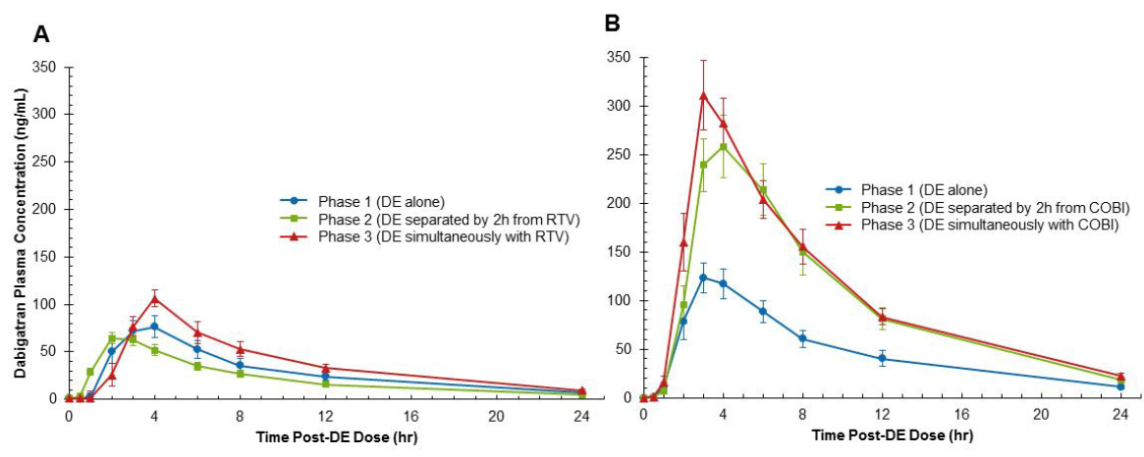
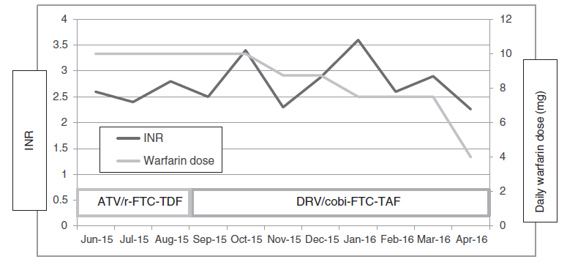
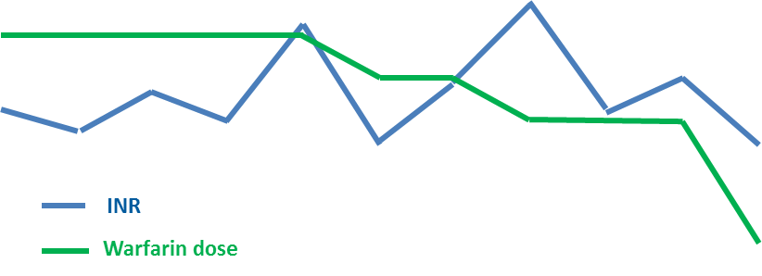
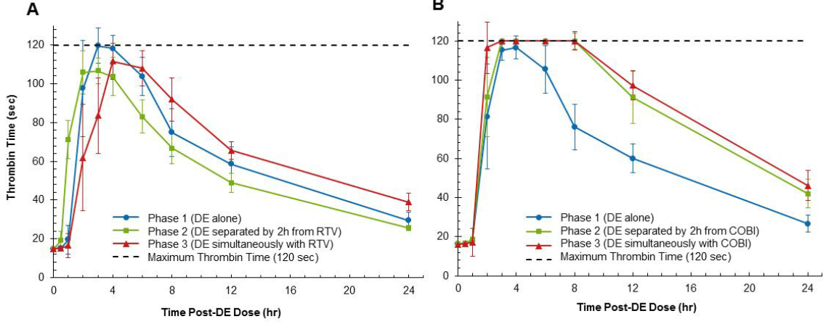
Anticoagulants + ritonavir or cobicistat boosting
Switch from ATV/r QD to DRV/c
➔ reduction of warfarin dose by 60%
PK/PD study for dabigatran + RTV or Cobi
dabigatran alone
dabigatran adm 2 h before RTV
dabigatran adm together with RTV
dabigatran alone
dabigatran adm 2 h before Cobi
dabigatran adm together with Cobi
PK
PD
RTV: mixed inhibitory/inducing effect on P-gp
Cobi: only inhibitory effect on P-gp
boosted regimens: use vitamin K antagonists and monitor INR or use heparin derivatives
boosted regimens: avoid rivaroxaban, apixaban. Possible to coadminister PI/r with dabigatran (dosage adjustment might be needed in patients with mild or moderate renal impairment), consider dose adjustment with edoxaban
Tseng A et al. AIDS 2017, Kumar P et al. AAC 2017, www.hiv-druginteractions.org

Slide 23

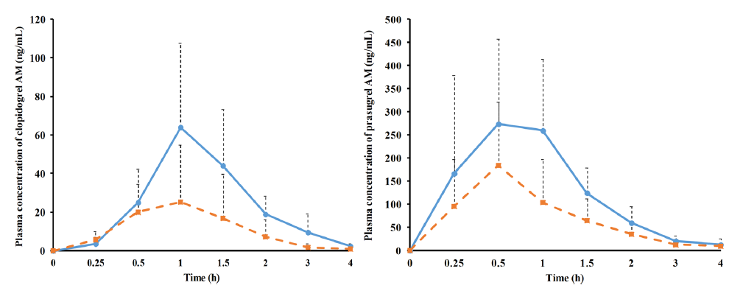
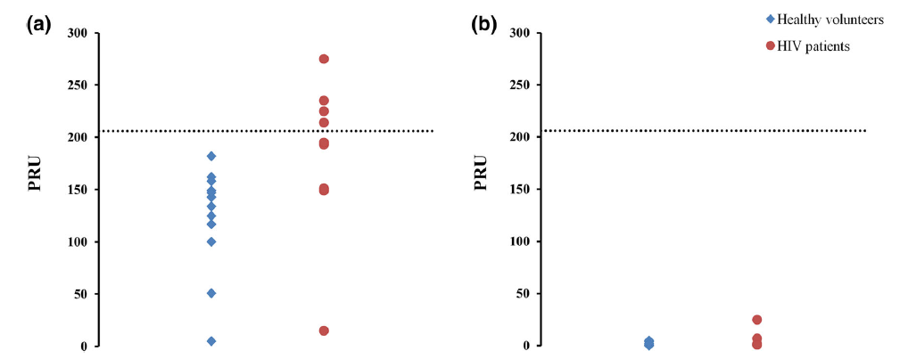
Drug-drug interactions between boosted ARV and antiplatelets drugs
PK effect
PD effect (platelet receptor blockade measured with VerifyNow®)
Clopidogrel
active metabolite
Prasugrel
active metabolite
Clopidogrel
Prasugrel
44% HIV patients did not
achieve platelet inhibition
platelet inhibition remains adequate in all patients
AUC -69%
AUC -52%
efficient platelet inhibition
antiplatelet drug alone
healthy volunteers
HIV patients
antiplatelet drug + RTV/Cobicistat boosted regimen
Second independent clinical study:
clopidogrel + RTV ➔ clopidogrel active met. AUC -49%
Second independent clinical study:
platelet aggregation inhibition: 51% (clopidogrel alone) vs 31% (clopidogrel + RTV)
Cases reports of the deleterious DDI between clopidogrel and boosted regimens start to emerge
use prasugrel unless patient has a clinical condition (e.g. history of stroke or transient ischaemic attack) which
contraindicates its use in which case an alternative HIV regimen should be considered
Marsousi N et al. Clin Pharmacokinet 2018; Itkonen MK et al. Clin Pharmacol Ther 2018, Bravo I et al. BJCP 2018, www.hiv-druginteractions.org

Slide 24
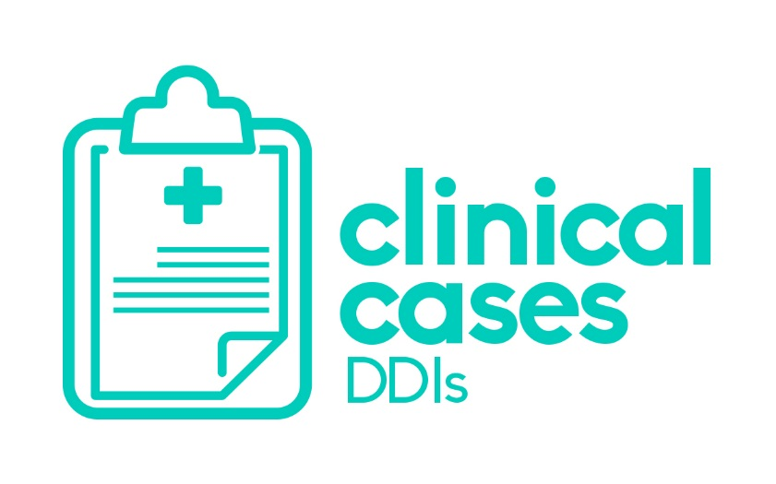



Outcomes of drug-drug interactions in real-life
www.clinicalcasesDDIs.com
The page can be used for:
Reporting new clinical cases on drug combinations
Searching for information on specific combinations.
Share information on real-life experience about drug combinations that may be used in the clinic.

Slide 25
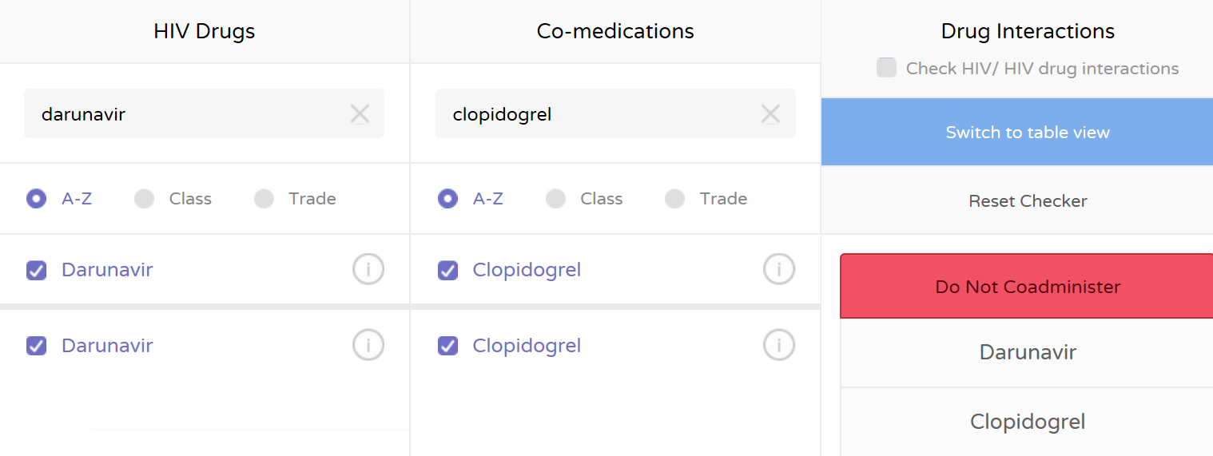
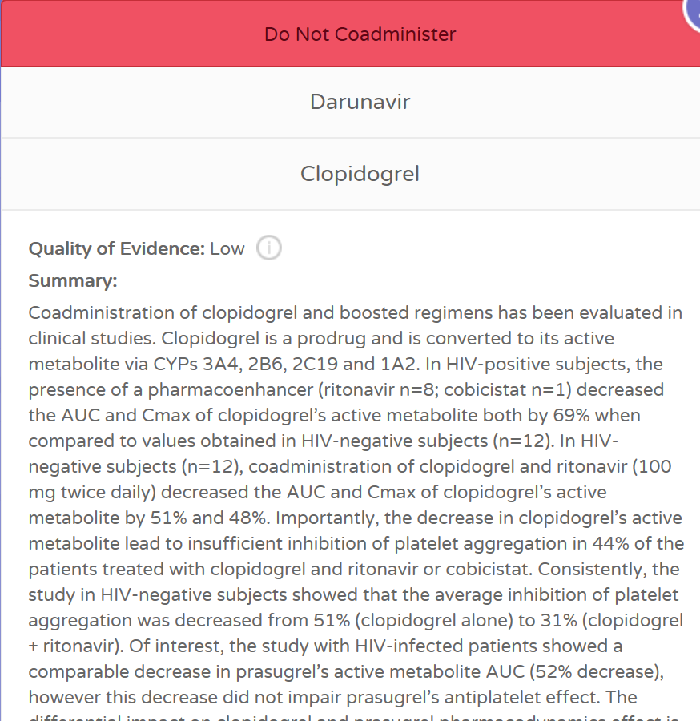
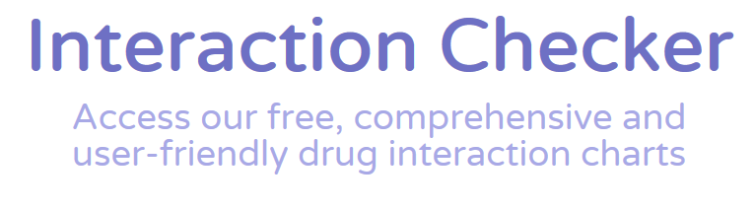

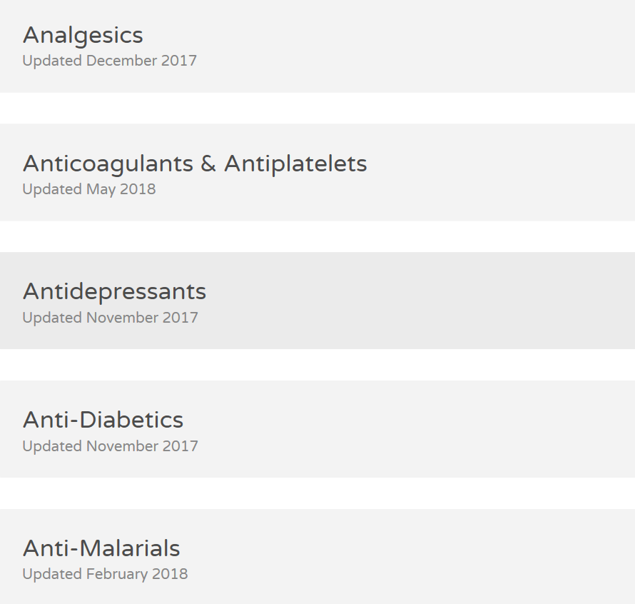
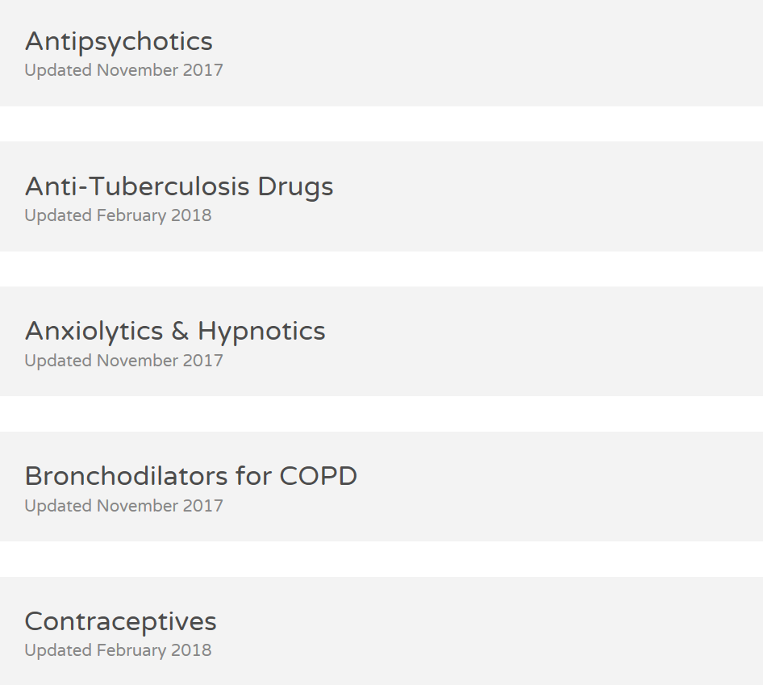
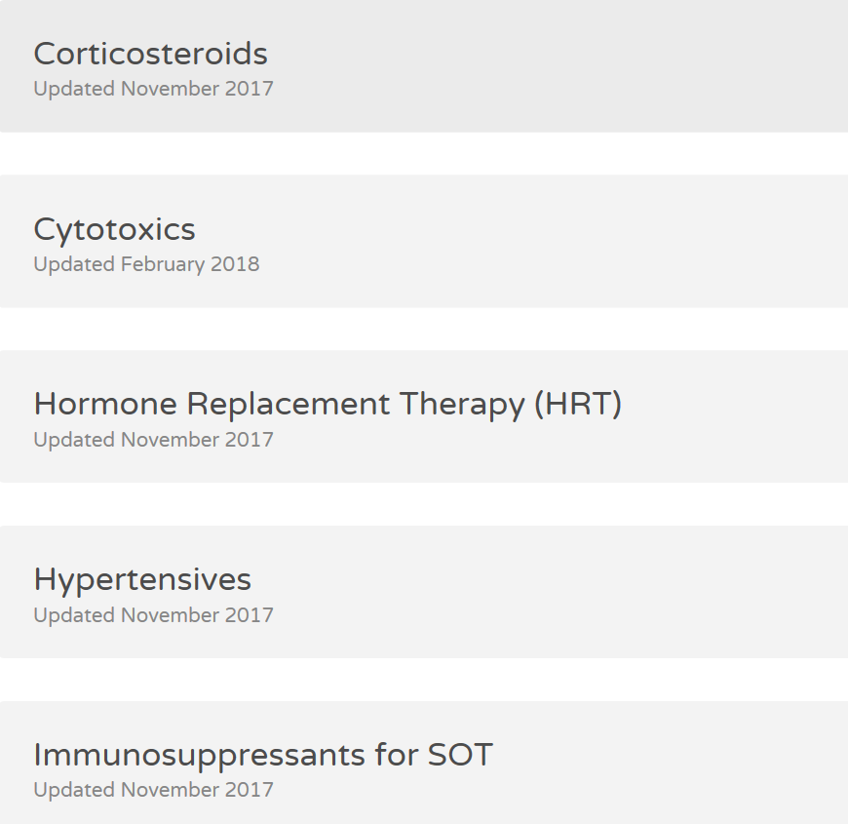
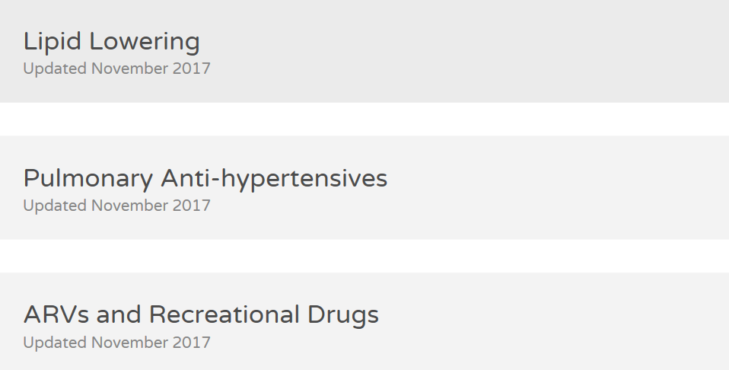
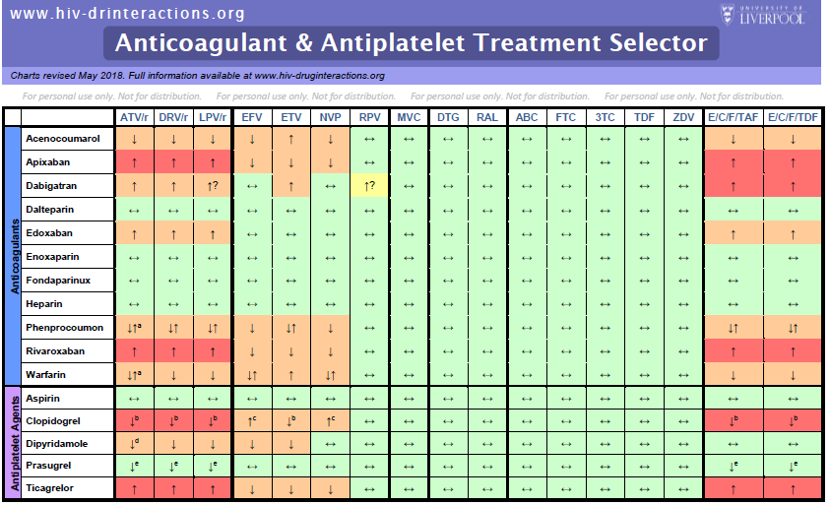
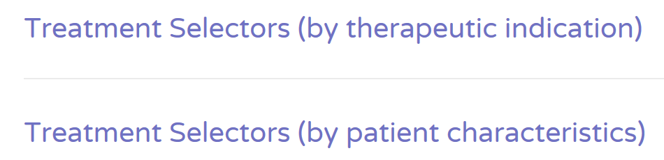
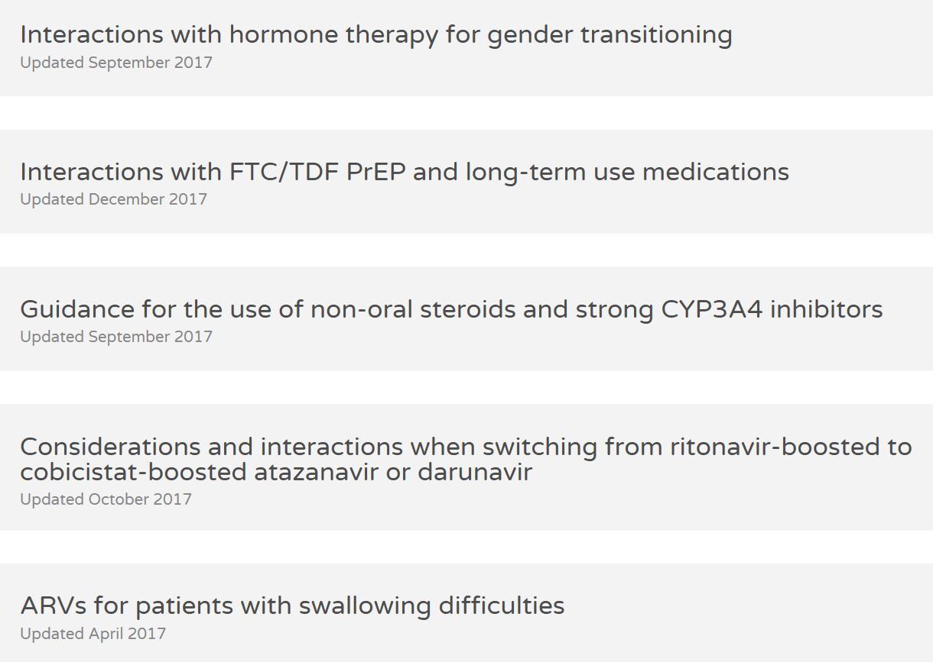
www.hiv-druginteractions.org
+ www.hep-druginteractions.org + www.cancer-druginteractions.org

Slide 26
Summary
DDIs are practically unavoidable in HIV care but mostly manageable.
Potential for DDIs to be considered systematically when selecting an antiretroviral regimen or when adding new medications to an existing HIV treatment.
Searchable online databases constitute valuable tools to recognise and manage DDIs.
Think beyond DDIs in elderly PLWH
➔ dose carefully; adapt dosage; check for inappropriate drugs; prioritize medications

Slide 27









Acknowledgements
Liverpool website team & editorial board
Manuel Battegay
Felix Stader
David Back
Saye Khoo
Marco Siccardi
Françoise Livio
Fiona Mara
Glasgow
Katie McAllister
Liverpool
Katie Moss
Liverpool
Justin Chiong
Liverpool
Jasmine Martin
Liverpool
Marta Boffito
London
Alison Boyle
Glasgow

Slide 28
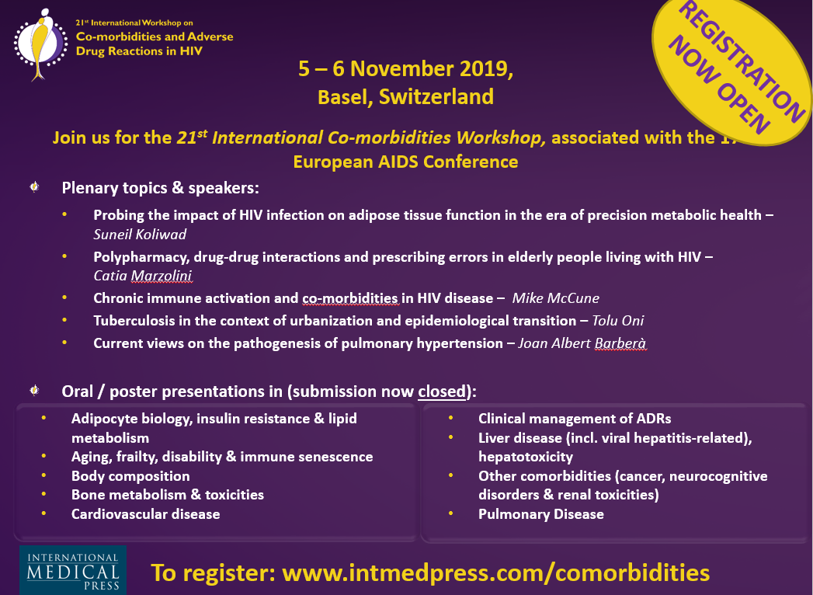

See you in Basel

